Slide 1
MALIGNANT COMMENTS CLASSIFICATION
Submitted by :- Parv Sharda

Slide 2
USE CASE:
The proliferation of social media enables people to express their opinions widely online. However, at the same time, this has resulted in the emergence of conflict and hate, making online environments uninviting for users. Although researchers have found that hate is a problem across multiple platforms, there is a lack of models for online hate detection.
Online hate, described as abusive language, aggression, cyberbullying, hatefulness and many others has been identified as a major threat on online social media platforms. Social media platforms are the most prominent grounds for such toxic behaviour.
Our goal is to build a prototype of online hate and abuse comment classifier which can used to classify hate and offensive comments so that it can be controlled and restricted from spreading hatred and cyberbullying.

Slide 3
DATA DESCRIPTION :
Project contain train and test dataset.
In train data set there are 159,571 rows and 8 columns.
In test data set it is like 153,164 rows and 2 columns.
There are no null values in the dataset
Most of the data are numeric in nature which are binary.
Comments is object in nature and consist of text.
Overall memory usage for train and test is around 15MB.

Slide 4
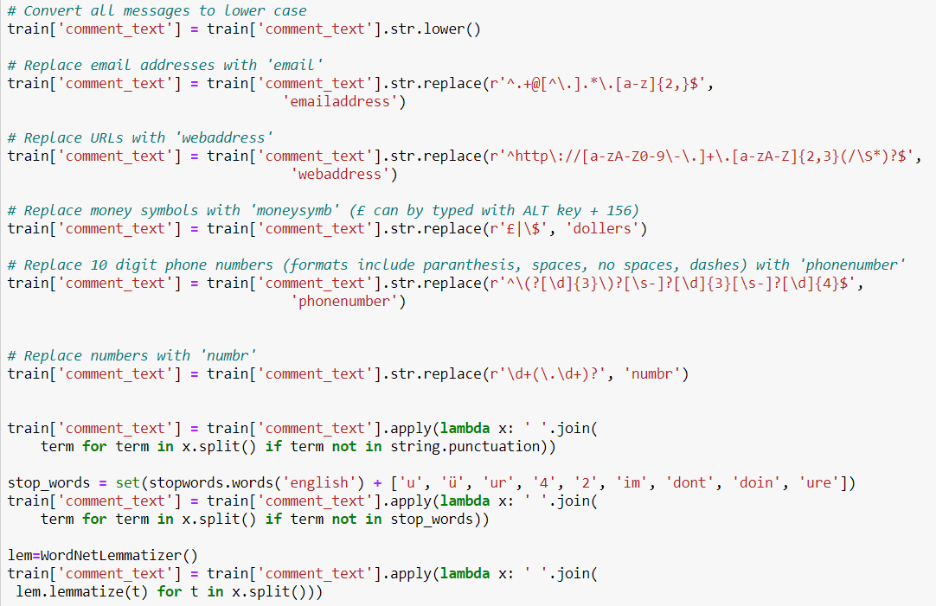
DATA PRE-PROCESSING :
# AS THERE ARE NO NULL VALUES IN THE DATASET, BUT AS THE COMMENT COLUMN IN TEXT FORMAT SO THERE REQUIRE LOT OF TEXT PRE-PROCESSING.

Slide 5
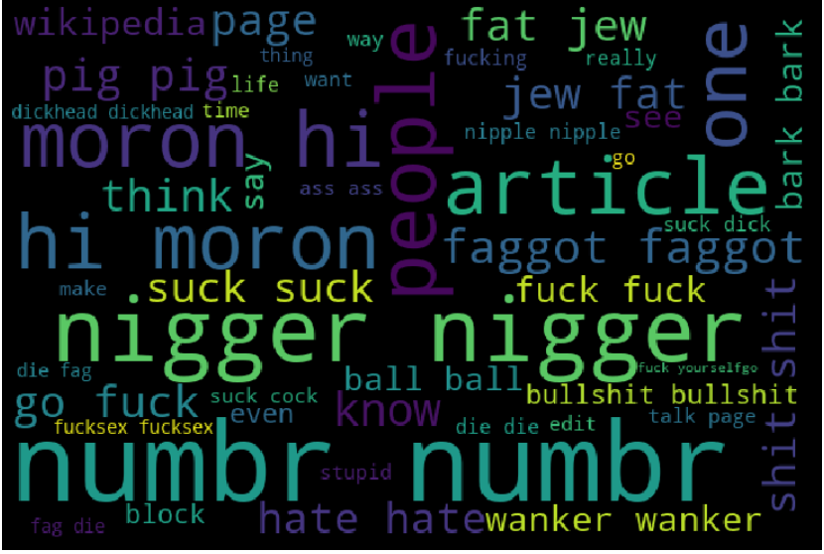
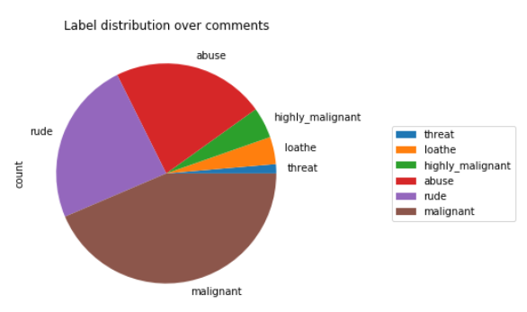
EDA

Slide 6
MODEL BUILDING :
The model building process involves setting up ways of collecting data, understanding and paying attention to what is important in the data to answer the questions you are asking, finding a statistical, mathematical or a simulation model to gain understanding and make predictions.
Evaluation Matrices:
Accuracy - it determines how often a model predicts default and non default correctly.
Precision-it calculates whenever our models predicts it is default how often it is correct.
Recall- Recall regulate the actual default that the model is actually predict.
Precision Recall Curve - PRC will display the tradeoff between Precision and Recall threshold.
F1 score - the F1-score, is a measure of a model's accuracy on a dataset. It is used to evaluate binary classification systems, which classify examples into 'positive' or 'negative'.
Cross Validations:
K Fold cross validations , K = 10

Slide 7
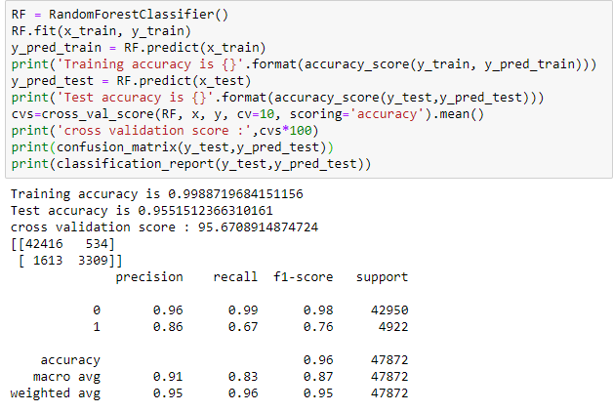
# RANDOM FOREST CLASSIFIER GIVING BEST RESULTS AMONGST ALL ALGORITHMS :

